Slide 1
Simplifying Windows Runtime and Deployment in Kubernetes

Slide 2





Who Are We?
Muzz Imam
SIG-Windows Contributor
Senior Program Manager, Microsoft
@Muzz Imam on K8s Slack
Deep Debroy
SIG-Windows Tech Lead
Engineering Manager, Docker
@ddebroy on K8s Slack
Mark Rossetti
SIG-Windows Co-Chair
Principal Software Eng, Microsoft
@Mark Rossetti on K8s Slack
Michael Michael
SIG-Windows Co-Chair
Director of PM, VMware
@m2 on K8s Slack
James Sturtevant
Sig-Windows Contributor /
Principal Software Eng,
Microsoft
@jsturtevant on K8s Slack

Slide 3
Agenda
Investments in key areas
Modernizing Legacy Apps
CAPI Demo
Q&A

Slide 4
Windows OS Updates
Latest Features
NanoServer 1809 support extended till 2024 (sames as LTSC 2019 support)
Single File Mapping is fully supported in all versions of Windows (requires containerd)
DSR support in Windows Server 2019 (October Release)
Windows Server version 2004 (Fully Supported)
Plans for v1.20
Bug Fixes (Networking, Virtualized Time Zone etc.)
Future
OS changes for Service Mesh
Session Affinity for Kubeproxy
MSMQ & MSDTC Scenarios support

Slide 5
Compute
Latest Features
containerD
Utilizes Host Compute Service (HCS) v2 schema
Support for single-file mappings (i.e. /etc/hosts, /dev/termination-log)
Pod termination grace period
Leverages CRI (Container Runtime Interface)
RuntimeClass support
Plans for v1.20
containerD stable release
GMSA support for containerD
GPU Support
Future
Privileged Containers
Hyper-V isolated containers support

Slide 6
Storage
Latest Features
New v1Alpha version of System API Group in CSI Proxy
New v1Beta versions of Disk and Volume API Groups in CSI Proxy
Support CSI Proxy as a native Windows Service
Github Action based unit and integration tests for CSI Proxy repository
Plans for v1.20
Continue to add APIs to CSI proxy to support CSI storage providers like vSphere and generic iSCSI
Analyze and improve latency of certain operations like partitioning a disk and formatting volumes
Introduce automated API documentation from API proto files
Migration path for plugins using CSI Proxy currently to use privileged container support in Windows
Future
CSI Proxy to stable
Add more storage providers to CSI proxy (AWS)
Deprecate in-tree storage plugins for Windows
Notes:
System API group in CSI Proxy targeting retrieval of BIOS data now and iSCSI related functionality (coming shortly) Disk and Volume API group enhancements to help with resize operations as well as disk online/offline around (SAN Policy)

Slide 7
Storage
GetPluginInfo
C:\var\lib\kubelet\plugins\csi-plugin\csi.sock
CSI Node Driver Registrar
CSI Node Plugin
Maintained and shipped by community
CSI Node Pod
Maintained and shipped by storage vendor
C:\var\lib\kubelet\plugins\csi-plugin\csi.sock
Disk APIs Volume APIs SMB APIs FileSystem APIs System APIs
NodeStageVolume NodeUnstageVoulme
NodePublishVolume NodeUnpublishVolume NodeResizeVolume NodeGetInfo NodeGetVolumeStats
GetInfo NotifyRegistrationStatus
C:\var\lib\kubelet \plugins_registry \csi-plugin-reg.sock
\\.\pipe \csi-proxy-api-group-v[N]
CSI gRPC over UDS
csiproxy gRPC interface over named pipe
kubelet.exe [ Plugin Watcher | CSI In-tree ]
csi-proxy.exe
Host OS (Windows)
Notes:
System API group in CSI Proxy targeting retrieval of BIOS data now and iSCSI related functionality (coming shortly) Disk and Volume API group enhancements to help with resize operations as well as disk online/offline around (SAN Policy)

Slide 8
Networking
Latest Features
DSR mode load balancing
Endpoint Slices support
Calico network policy open sourced
Antrea CNI support for Windows including network policies
Envoy proxy alpha release
Plans for v1.20
Promote Envoy proxy to beta
IPv4/IPv6 dual stack networking (L2bridge network + Azure CNI on Windows Server, version 2004)
“externalTrafficPolicy=local” support for client IP preservation
Future
Full Service Mesh Support (OSM, SMI, etc)
IPv4/IPv6 dual-stack networking (for Overlay networks)

Slide 9
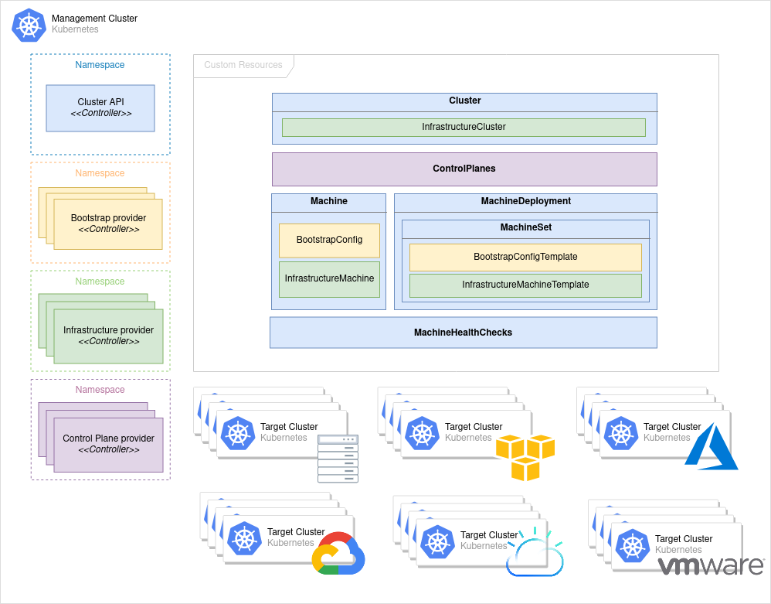
Cluster Lifecycle
Adding Windows Support to Cluster API during 1.20
Using Kubeadm
Cloudbase-init
Workload Clusters only
Each Provider must add support for Worker nodes
Cluster API Concepts:
Management Cluster
Workload Clusters
Future:
kubeadm support goes GA
Image from: https://cluster-api.sigs.k8s.io/user/concepts.html
Notes:
for a few releases now, we have added ability to add windows worker nodes including adding support for kubeadm in beta. As we move forwards we want to make it easier to and so we are

Slide 10
Modernizing Legacy Apps
Start with lift-and-shift and then evaluate about splitting monolights into microservices
​Web-based applications are the low-hanging fruit for modernization into containers
Containerization of Application locally is the most critical first step. You could do it manually or with tools like Windows Admin Center Container Extension https://techcommunity.microsoft.com/t5/itops-talk-blog/how-to-manage-containers-with-windows-admin-center/ba-p/1459437
Don’t underestimate the importance of Linux nodes (DNS and other key components)

Slide 11
Modernization Gotchas
Image Selection - Use derived images to share application building blocks & dependencies
​Use of Windows Registry as storage
Modernize the use of local storage
​Kernel drivers or application drivers that don’t exist in Windows Containers
​Active Directory support at the OS level
​.NET version compatibility and support of key requirements (WCF for example)
​Database requirements
​Certificate management
​Other application dependencies (Windows API dependencies, MSMQ MSDTC etc)
​Do you have the source code for the application? (Use process monitor, fiddler, etc)
​Use the .NET Portability Analyzer to evaluate workloads
OS Patching

Slide 12
DEMO

Slide 13
How you can contribute
Join our weekly meetings at 12.30pm Eastern every Tuesday
View the recorded community meetings
Help us write additional documentation and user stories
Find bugs you can fix in our project board (start with “good first issue”)
Review open PRs

Slide 14





Windows Community
Michael Michael
Co-Chair
Director of PM, VMware
@m2 [Slack]
@michmike [GitHub]
Mark Rossetti
Co-Chair
Principal PM, Microsoft
@Mark Rossetti [Slack]
@marosset [GitHub]
Deep Debroy
Technical Lead
Engineering Manager, Docker
@ddebroy [Slack, GitHub]
Slack.k8s.io
#sig-windows
https://groups.google.com/forum/#!forum/kubernetes-sig-windows
https://kubernetes.io/docs/setup/production-environment/windows/
https://github.com/kubernetes/community/tree/master/sig-windows
YouTube Playlist
https://zoom.us/j/297282383
Every Tuesday @ 12.30pm EST

